Slide 1

Question –Answer Forum
By Group,
VENUS

Slide 2


Slide 3
Contents
Description Of Problem
Objective
Features
Originality And Social Impact
Target Users
Development Timetable
Designing
Reference

Slide 4


Slide 5
Description Of Problem
Internet provides us lot of information regarding our problem/s.
However, it is difficult to resolve which are correct and appropriate in short time period.
So what is the solution to get accurate and relevant answers for a particular problem?

Slide 6


Slide 7
objective
To Solve this problem, Team Venus is proposing to build Question-Answer Forum app.
It will help user to get correct and relevant answer to his/her question.
User will get opportunity to become part of discussion and feedback.

Slide 8


Slide 9
Features
This app will allows user to register using unique username and password.
Each user will have unique portfolio page.
User can post questions and answers to the forum.
User can give feedback by liking and disliking for given answers.
It will allows user to add new topics in the forum.
User can search topics/questions already present in forum.
User can see popular questions and topics in the forum.

Slide 10


Slide 11
originality

Slide 12


Slide 13
Social Impact

Slide 14


Slide 15
Target users

Slide 16


Slide 17
Development Timetable
Phase One: Login and Registration Module
Phase Two: User Activity Module
Phase Three: Campus Updates Module
Phase Four: Final Integration of all Modules and Documentation

Slide 18


Slide 19
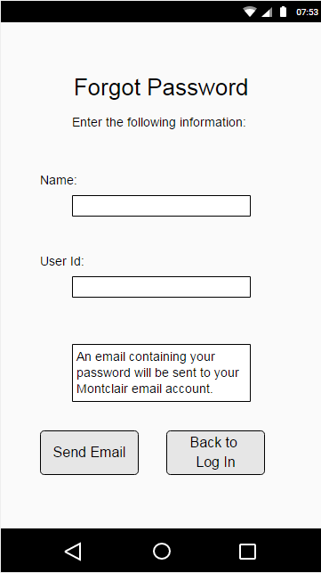
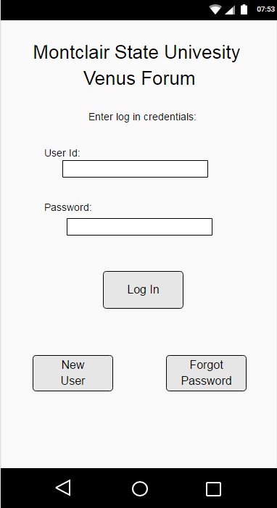
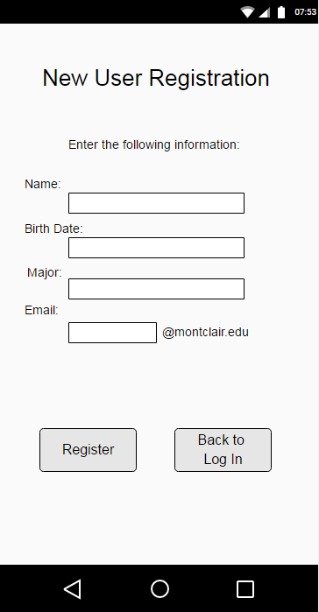
Designs

Slide 20
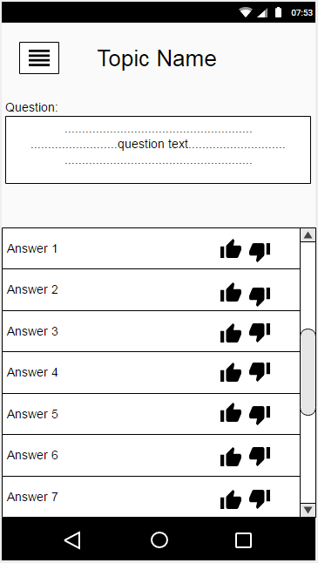
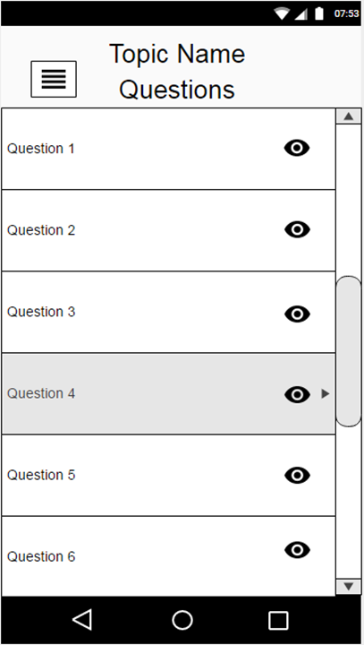
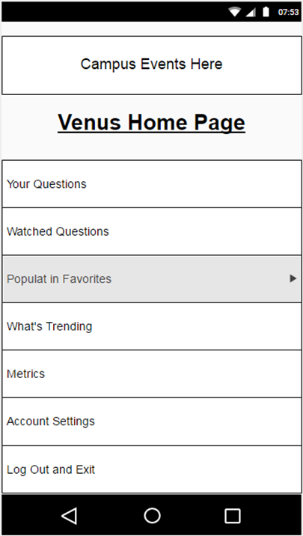
designs

Slide 21


Slide 22
References
Stack Overflow and Quora: like our app, stack overflow and Quora supply their users with an environment to post questions, receive answers, and “like” those answers based on their relevance to a question. Our app will incorporate similar functions, but its primary focus will be Montclair State University students and our extra features will reflect that.

Slide 23


